Slide 1
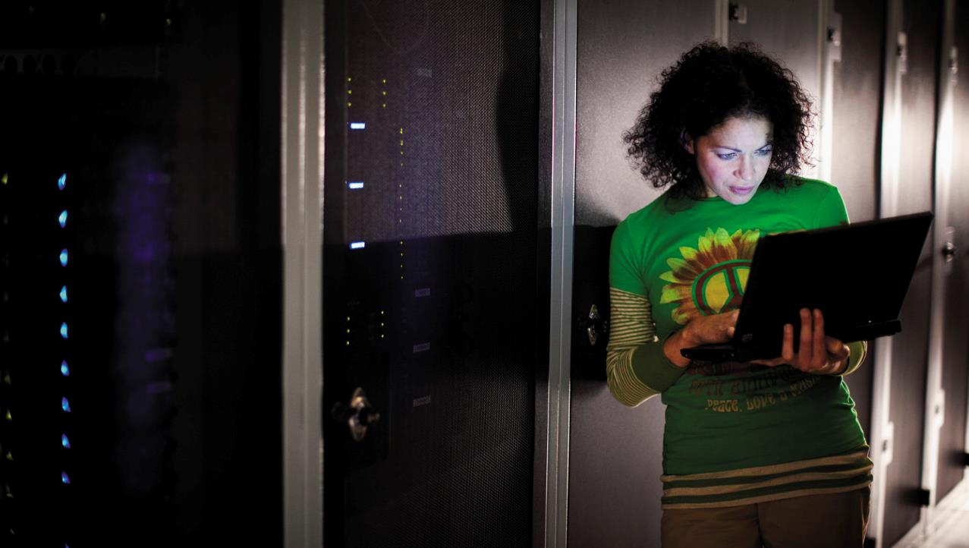
Welcome
Windows Azure Dev Camp

Slide 2

Wi-Fi
PLEASE…
DO NOT USE
MSFTOPEN
WE ARE USING IT FOR THE LIVE STREAM!
Please connect to the Wi-Fi network SSID: MSFTGUEST
USER: usmsguest PDW: Q98e864o (case sensitive)
You will need to open a browser to connect.

Slide 3
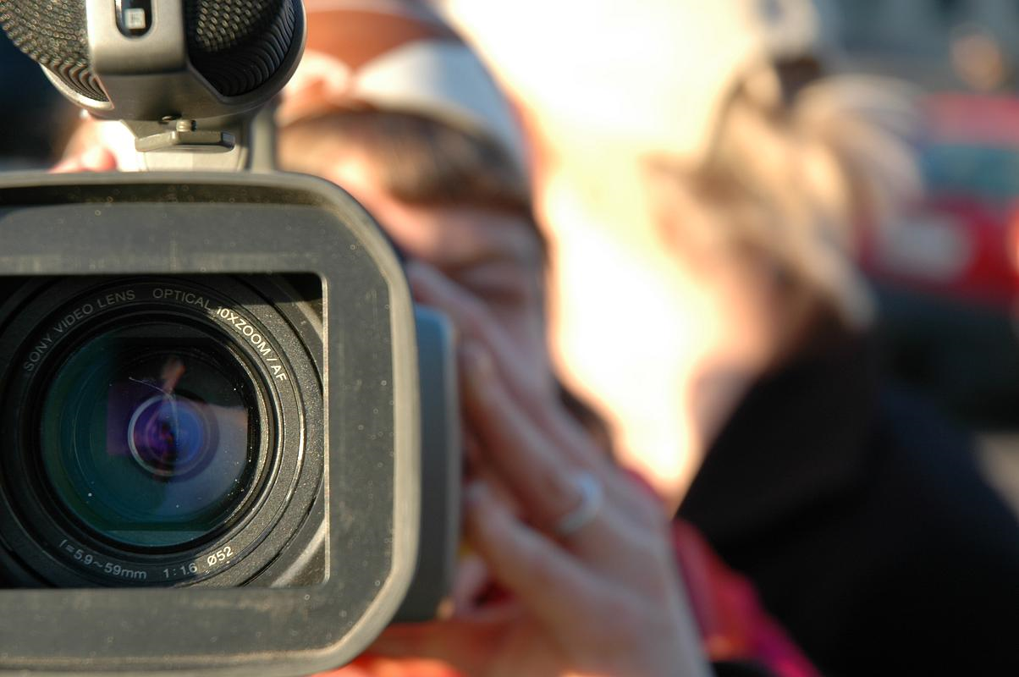
What’s with the cameras?
Today’s event will be live-streamed!
Feel free to share the link:
http://aka.ms/devcamponline

Slide 4

Today's Schedule
Time | Activity / Session Title
8:15am – 9:00am | Guest arrival, Registration, Continental Breakfast, Guest setup
9:00am – 9:30am | Windows Azure Technical Overview
9:30am – 10:30am | A look at the Modern Principles
10:30am-10:45am | Break
10:45am – 11:45pm | Introduction to Modern Dev/Test Practices
11:45pm – 12:00pm | Live Stream Wrap-Up and Additional Resrouces
12:00pm-4:00pm | Lunch for on-site attendees Open lab time. Attendees can work on labs from the http://aka.ms/bslabs download
Notes:
Deck 0 should be shown during event setup, as people are coming in.
This schedule is a loose guideline. You should proactively monitor the attendees progress in labs. Set check points with them, and move forward if people are comfortable with what they have done, or are completed. Keep the day loose and flowing. It is possible for someone to finished lab 1 during lab 2’s time. At the end, as long as they have gotten some hands one time, and played with what interests them, then we have succeeded.

Slide 5

How to get started
Get free trial aka.ms/AzureCampsTrial
Download lab materials aka.ms/BSlabs

Slide 6

Labs
The hands-on labs are available at http://aka.ms/bslabs If you have problems accessing them, ask a proctor for help

Slide 7

© 2013 Microsoft Corporation. All rights reserved. Microsoft, Windows, Windows Vista and other product names are or may be registered trademarks and/or trademarks in the U.S. and/or other countries.
The information herein is for informational purposes only and represents the current view of Microsoft Corporation as of the date of this presentation. Because Microsoft must respond to changing market conditions, it should not be interpreted to be a commitment on the part of Microsoft, and Microsoft cannot guarantee the accuracy of any information provided after the date of this presentation. MICROSOFT MAKES NO WARRANTIES, EXPRESS, IMPLIED OR STATUTORY, AS TO THE INFORMATION IN THIS PRESENTATION.

